Slide 1

Problem Statement
Log Analysis
Centralized Log Management
Live Error Analysis

Slide 2
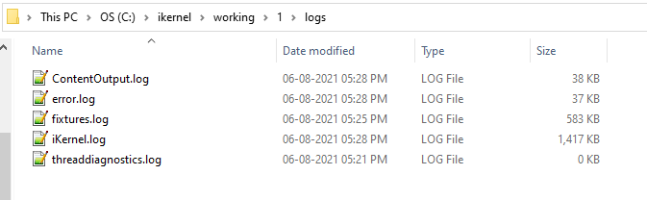

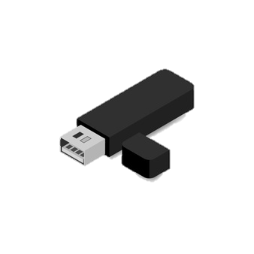
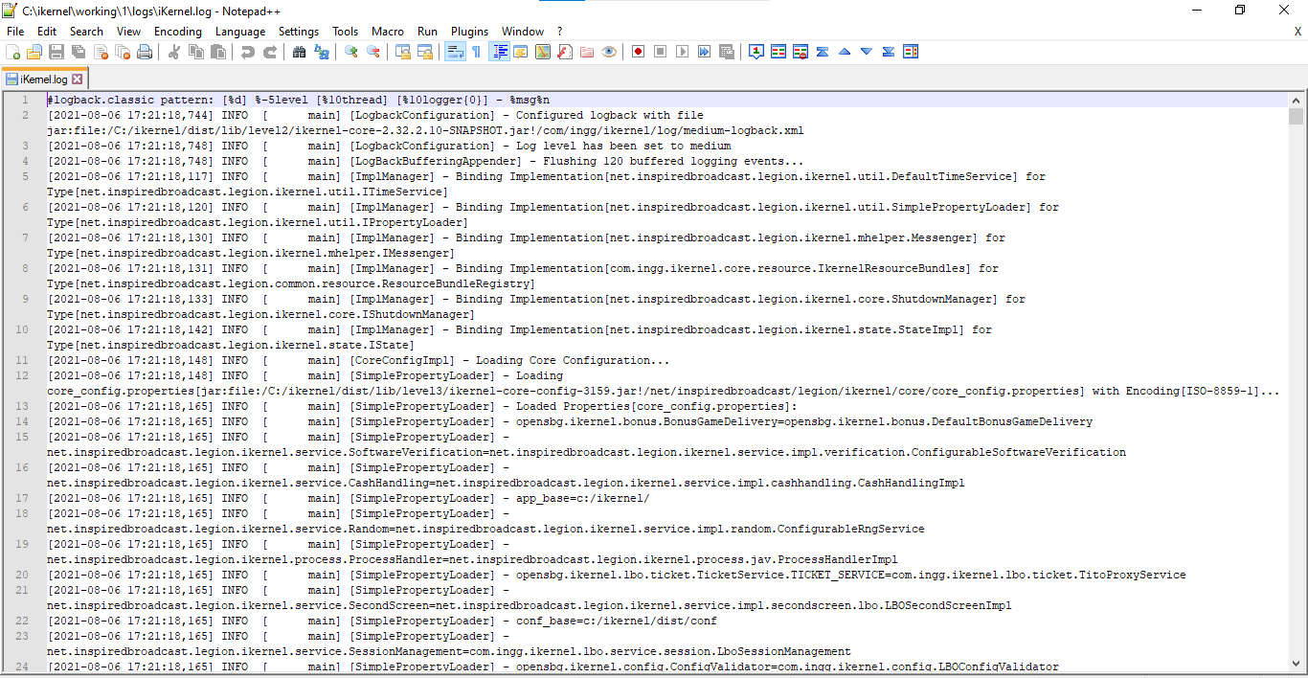

Slide 3

STACK
Elasticsearch, Logstash and Kibana

Slide 4
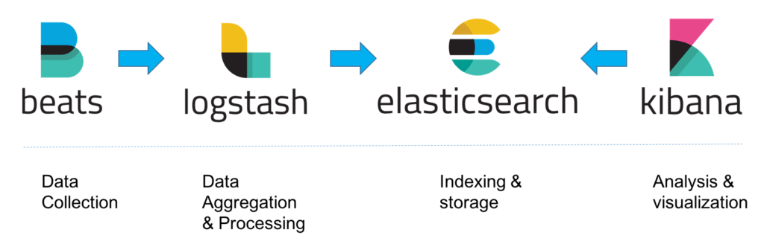

Slide 5
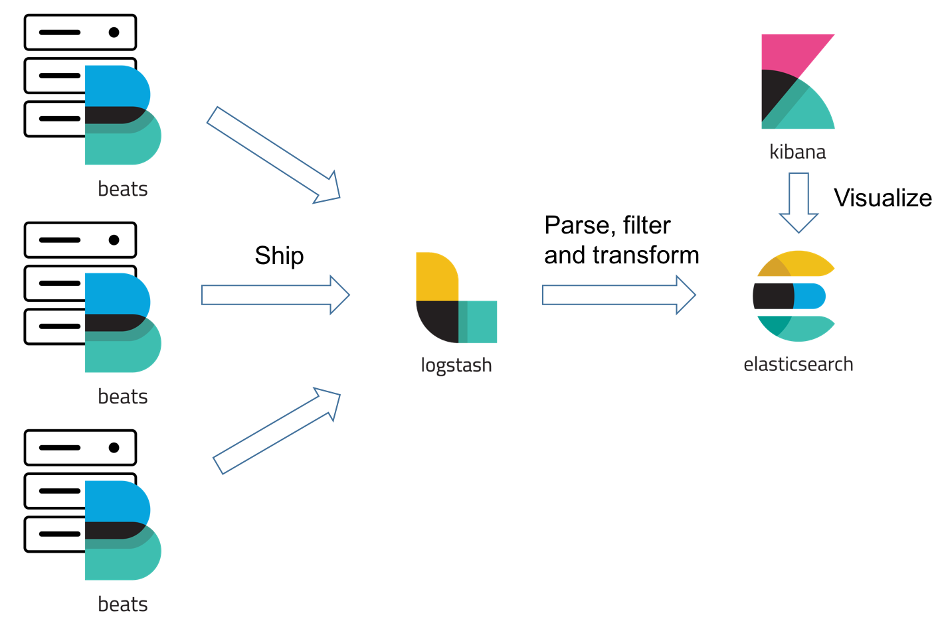

Slide 6
Flow Diagram
FileBeat
Logstash
Elastic Search
Kibana
i/p : configured with the log file paths
o/p : Logstash port 5044
i/p : output from beat port 5044
o/p : Elasticsearch (path) and index name
indices
i/p : configured to listen to the ES instance running
o/p : Console and many more

Slide 7

High Level Architecture
Terminal
Server
Logstash
FileBeat
Elastic Search

